Slide 1


InnovAct 2025
IOTIFY
ENERGY CONSERVATION
TEAM IOTIFY
YATIN THARUN SWETHA
25BVD0040 25BVD0021 25BVD0025

Slide 2

ENERGY WASTAGE
Energy wastage happens when energy is produced but not used effectively or is lost along the way, in storage, or during use. Examples are leaving lights on in empty rooms, running inefficient motors when they are not needed, or using old appliances that use more power than necessary.
Energy wastage happens everywhere and in almost every way but the place where it happens the most is in domestic circuits which is due to our carelessness in forgetting to switch off fans and lights when we leave a room

Slide 3
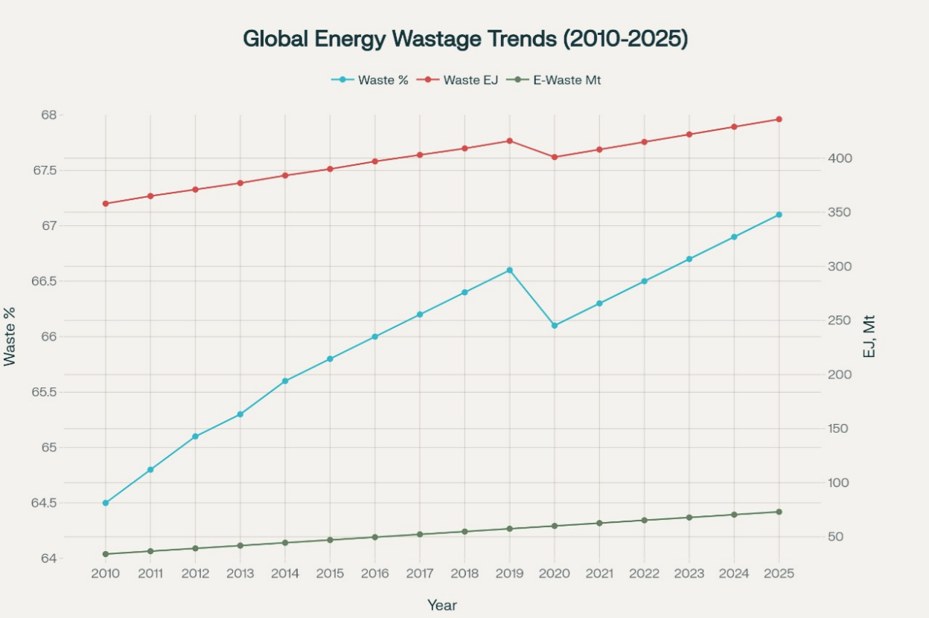

Slide 4
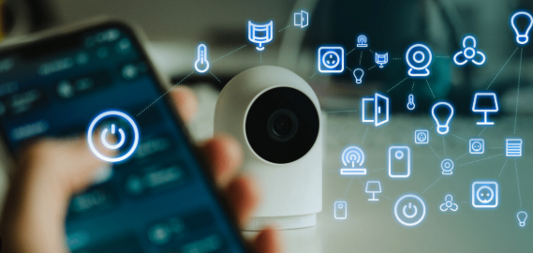
INTRODUCING IOTIFY: YOUR SMART ENERGY PARTNER
At the center of our solution is IOTIFY, a groundbreaking IoT device that allows you to control your energy use. IOTIFY fits easily into your home and manages appliances directly from the MCB. This smart device lets users monitor, manage, and improve their energy consumption, turning regular homes into smart, energy-efficient spaces.

Slide 5
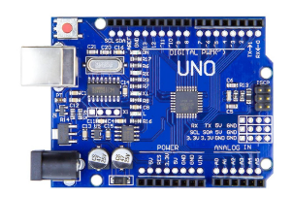
HOW IT WORKS
We have mainly used arduino uno, ESP8266 WiFi module to make the non smart devices smart. The appliances are connected to the arduino through relay. The WiFi module is also connected to the arduino
The Arduino Uno in our project serves as the main microcontroller. It processes input from connected devices, manages communication, and controls data flow. Even without sensors, it carries out commands and shares information between the WiFi module (ESP) and the user interface. It runs the programmed logic to manage energy usage data. This enables communication with the mobile app or dashboard and allows control over connected appliances. The Arduino Uno is essential for coordinating system functions and ensuring real-time energy management and monitoring.

Slide 6
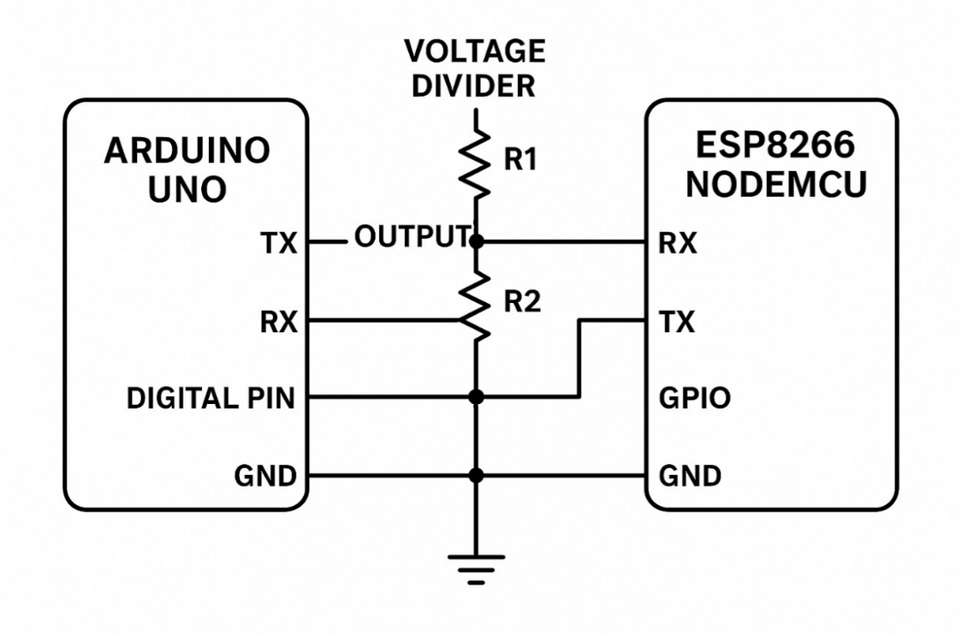
HOW IT WORKS
The WiFi module (ESP) in your project allows wireless communication between your energy management system and external devices, like smartphones or remote servers. It enables real-time data transfer and remote control, which makes it easy to monitor and manage energy usage from anywhere. This module supports multi-terminal communication and ensures smooth connectivity for improved system flexibility and user convenience.

Slide 7
HOW IT WORKS
The arduino uno is connected to a server that is a laptop in our case, the server is connected to a client. The client has an interface to access and control the functioning of appliances connected to the arduino
The client, has a basic login interface that gives each user uniqueness to access their devices seamlessly, this ensures security and also eliminates possible miss usages
Communication between,the client and cloud is done through websocets,which is a full duplex comms protocol superior to https and is more useful in real time feedback mechanisms
There is a database server that is running on the cloud system that provides the structured architechture to store user details and also efficiently access the devices uniquely without redundancy

Slide 8
CHALLENGES FACED
WiFi interfacing using ESP Module:
One of the main challenges we faced during development was the WiFi interfacing using the ESP module (ESP8266). Integrating this WiFi module with our system to ensure reliable and consistent wireless communication was tough. We dealt with issues like maintaining stable connections, managing data transmission delays, and troubleshooting compatibility with other components in the system. To overcome these technical challenges, we needed to conduct extensive testing and debugging, along with making adjustments to the firmware and network setup for smooth communication.

Slide 9
FUTURE SCOPE
Mobile App: This gives users easy, on-the-go access for real-time monitoring and control.
Multiple User Interfaces: This offers different interfaces to suit various users, such as admins, consumers, and technicians, which improves usability.
Multi-Terminal Communication: This allows seamless data sharing and remote access across multiple devices, enabling collaboration and integration with other smart systems.
Device Monitoring: This includes real-time device monitoring to track the performance and energy use of individual devices. It helps users identify inefficiencies and optimize usage.

Slide 10

BENEFITS
Significant Savings. Real-time monitoring and smart control cut down on unnecessary energy use. This leads to lower utility bills and long-term financial savings.
Eco-Friendly Impact. Using less energy results in a smaller carbon footprint. It helps protect the environment by cutting greenhouse gas emissions and supports sustainability goals.
Extended Appliance Life Span. Smart management reduces power surges and overuse. This allows appliances to operate more efficiently and last longer, which minimizes maintenance costs and waste.

Slide 11
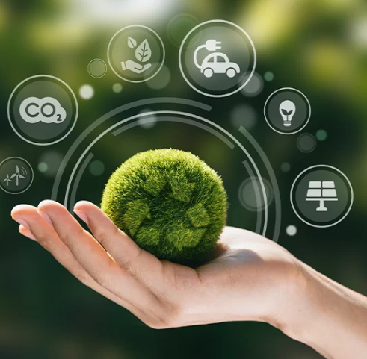
REAL WORLD IMPACT
Massive Energy Savings: Smart energy management systems and monitoring can cut household and business energy use by 10 to 22 percent. This leads to significant savings on electricity costs around the world. In some communities and businesses, these solutions have reduced annual consumption and bills by over 20 percent. This shows real financial and environmental benefits.
Global Sustainability: By cutting unnecessary energy use, these systems help lower carbon emissions and decrease the reliance on fossil fuels. Widespread adoption could drive down residential CO₂ emissions by 20 percent or more. This directly supports climate goals and contributes to a greener, more sustainable future.

Slide 12
WHY OUR DEVICE STANDS OUT
Fixed Installation Requiring Technical Support: Our device is made for fixed installation within the electrical system. It needs professional help to ensure proper setup and integration. This ensures reliable and stable operation suited to the unique needs of each environment.
Unified Control: It provides centralized management of all connected appliances and systems through one dashboard or mobile app. This simplifies monitoring and improves energy use.
Friendly Interface: The system has a simple, easy-to-use interface. It allows users of all experience levels to manage their energy consumption effectively and save more.
This mix of secure, professionally supported installation, centralized control, and
user-friendly design guarantees great performance and ease of use.

Slide 13
THANK YOU!
FOR YOUR ATTENTION

